Slide 1


Course Title: Introduction to Blockchain and distributed ledger
Course Code: 19CS3618
PRESENTED BY:
TEJAAL M
ENG19CS0334
F SECTION
6 TH SEMESTER
25/04/2022

Slide 2




BLOCKCHAIN FOR DEEP LEARNING:
REVIEW AND OPEN CHALLENGES

Slide 3
INTRODUCTION
In summary, the key contributions of this paper are as follows:
• We devise a taxonomy to categorize and classify the existing literature related to blockchain-based deep learning frameworks based on seven important parameters.
• We present insights into the state-of-the-art blockchain-based deep learning frameworks by highlighting their strengths and weaknesses.
• We compare the blockchain-based deep learning frameworks based on important parameters.
• We discuss several research challenges that can affect the performance, accuracy, and prediction quality of existing blockchain-based deep learning frameworks.

Slide 4
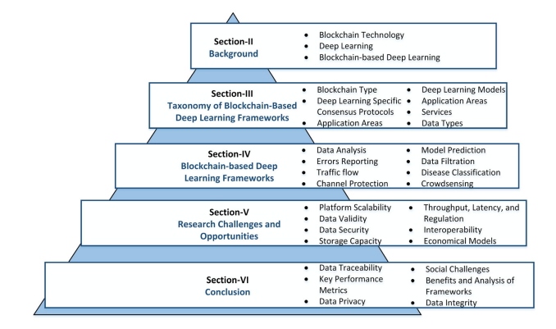
Organogram of the paper

Slide 5
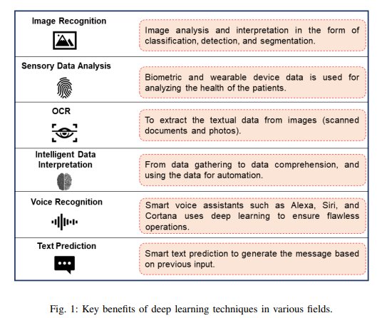
INTRODUCTION

Slide 6
BACKGROUND
Blockchain Technology
Deep learning
Blockchain-based Deep Learning
Data Security
Automatic Decision Making
Cumulative Judgements
Enhanced Robustness

Slide 7
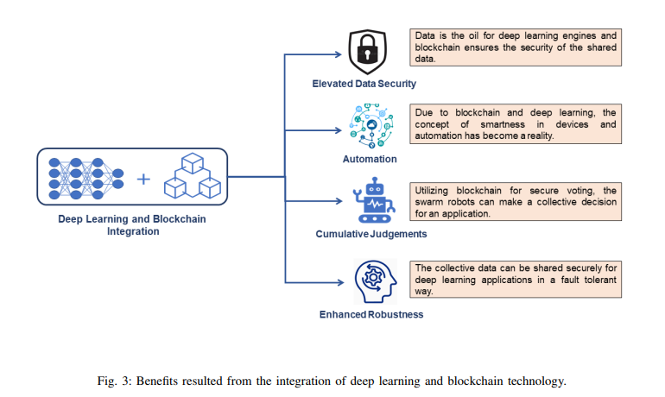
BACKGROUND

Slide 8
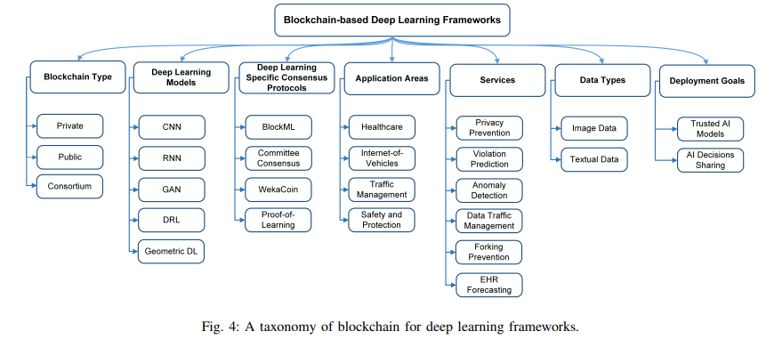
BACKGROUND

Slide 9
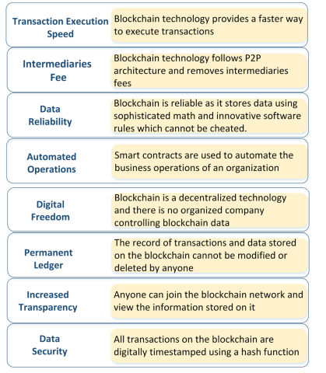
BACKGROUND
Advantages of Blockchain technology

Slide 10
TAXONOMY OF BLOCKCHAIN-BASED DEEP LEARNING FRAMEWORK
A. Blockchain Type
a. Public Blockchain:
b. Private Blockchain:
c. Consortium/Federated Blockchain:
B. Deep Learning Models
a. Convolution Neural Network
b. Recurrent Neural Network
c. Generative Adversarial Networks (GAN)
d. Deep Reinforcement Learning (DRL)
e. Geometric Deep Learning
f. Deep Learning Specific Consensus Protocols
C. Deep Learning Specific Consensus Protocols
a. BlockML
b. Committee Consensus Mechanism
c. WekaCoin
d. Proof-of-learning
D. Application Areas
a. Healthcare:
b. Internet of Vehicles
c. Traffic Management
d. Safety and Protection

Slide 11
TAXONOMY OF BLOCKCHAIN-BASED DEEP LEARNING FRAMEWORK
E. Services
a. Privacy Preservation
b. Violation Prediction
c. Anomaly Detection
d. Data Traffic Management
e. Forking Prevention
f. EHR Forecasting
F. Data Types
a. Image Data
b. Textual Data
G. Deployment Goal
a. Trusted AI Models
b. AI Decisions Sharing

Slide 12

CNN

Slide 13
RNN

Slide 14
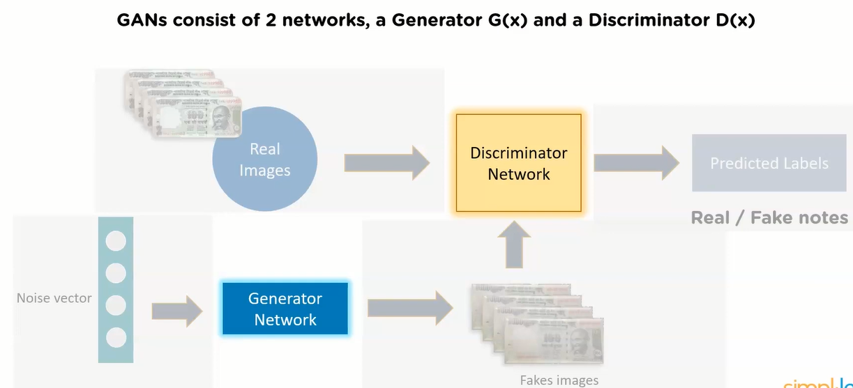
GAN

Slide 15
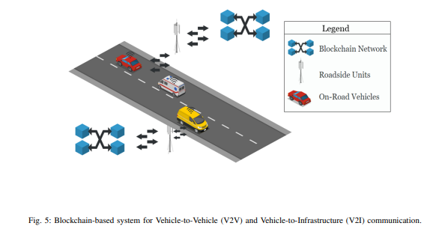
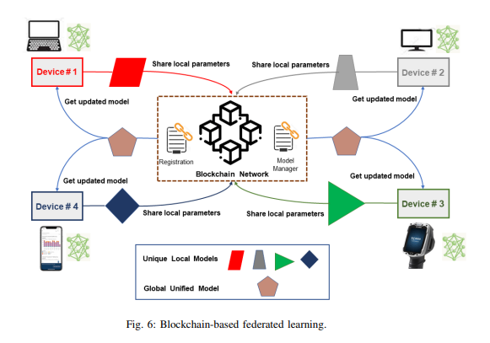
Geometric Deep Learning
Violation Prediction

Slide 16
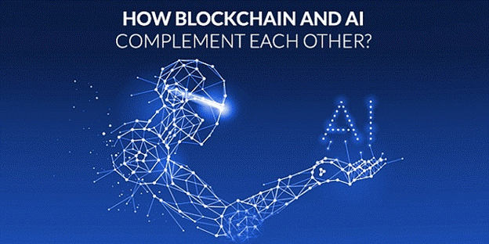
BLOCKCHAIN-BASED DEEP LEARNING FRAMEWORK
A.Review of Blockchain-based Deep Learning Frameworks
a.Data Analysis
b.Provenance Data for AI Models
c.Model Prediction
d.Data Filtration
e.Disease Classification
f.Combined Cooperative Positioning
g.Crowdsensing
h.Errors Reporting
i.Crowdsourcing
j.Traffic flow Prediction
k.Computations Offloading
l.Channel Protection
m.Utility-based Blockchain Security
B.Comparison of Existing Frameworks

Slide 17
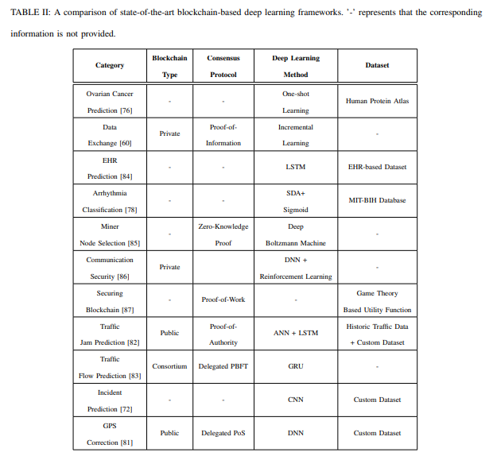
Computations Offloading

Slide 18
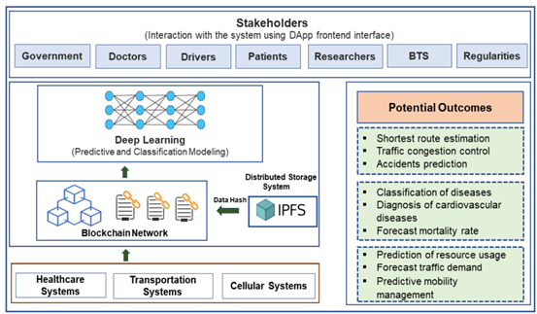
Highlighting the system components and participants and describing the outcomes resulting from the integration of deep learning with blockchain technology in various fields

Slide 19
RESEARCH CHALLENGES AND OPPORTUNITIES
Platform Scalability
-compression algorithms
Data Validity and Secure Sharing
-encryption and decryption techniques implemented by private blockchain platforms

Slide 20
Structural Enhancement and Storage Capacity
-Deep learning approaches can be employed for compressing the data as well as assisting in minimizing the redundant data.
-Since data stored on the blockchain is permanent, hence, the growing size of the ledger is a big concern and needs to be addressed properly.
Platform Throughput and Latency
significantly affect the quality of service (QoS)
the Ethereum blockchain platform offers a throughput of 16.5 transactions per second
private blockchain platforms such as Hyperledger Fabric can execute several thousands of transactions in one second.

Slide 21
RESEARCH CHALLENGES AND OPPORTUNITIES
Cryptocurrencies, Deep Learning-based Consensus Protocols, and Regulations
-Supervised deep learning models can be used to predict the future of cryptocurrencies.
-Lack of standards and regulatory frameworks is another challenge
High-Speed Computing/Storage Devices and Platform Interoperability
-spike in management costs and complicity
Secure Economical Models
-Currently, existing deep learning models require high-performing computing devices for training purposes
-the blockchain is an expensive storage medium. More research is needed to propose cost-efficient, resource-friendly, fast, and high-performance-based blockchain-assisted deep learning frameworks.

Slide 22
CONCLUSION
My concluding remarks along with the key recommendations include:
Data traceability, immutability, and integrity features of blockchain technology can assist in identifying the volume and type of data collected to train deep learning models.
The key performance metrics such as system throughput, execution latency, and block propagation time, data volume, conflicting interests of participants, and smart contract vulnerabilities can significantly impact the effectiveness of existing blockchain-based deep learning systems.
Private blockchain platforms ensure data privacy through private channels and access control policies. However, public blockchain platforms are prone to data privacy leakage problems because they have a zero-access control policy.
Public blockchain platforms can successfully capture the evolution of deep learning models as it progresses and records the model state during its creation, updating, or usage stages.
Deep learning approaches can be employed for compressing the data as well as minimizing the redundant data.

Slide 23
REFERENCES
Blockchain for deep learning: review and open challenges
Muhammad Shafay, Raja Wasim Ahmad, Khaled Salah, Ibrar Yaqoob,Raja Jayaraman,Mohammed Omar
The Author(s), under exclusive licence to Springer Science+Business Media, LLC, part of Springer Nature 2022
https://link.springer.com/article/10.1007/s10586-022-03582-7
https://www.researchgate.net/publication/355566281_Blockchain_for_Deep_Learning_Review_and_Open_Challenges
https://www.techrxiv.org/articles/preprint/Blockchain_for_Deep_Learning_Review_and_Open_Challenges/16823140
https://ieeexplore.ieee.org/abstract/document/8598784%20/keywords#keywords

Slide 24
THANK YOU

